Slide 1
ENG 346 Data Structures and Algorithms for Artificial Intelligence Graphs
Dr. Mehmet PEKMEZCİ
mpekmezci@gtu.edu.tr
https://github.com/mehmetpekmezci/GTU-ENG-346

Slide 2
Graphs
A graph is a pair (V, E), where
V is a set of nodes, called vertices
E is a collection of pairs of vertices, called edges
Vertices and edges are positions and store elements
Example:
A vertex represents an airport and stores the three-letter airport code
An edge represents a flight route between two airports and stores the mileage of the route
849
PVD
1843
ORD
142
SFO
802
LGA
337
1743
1387
HNL
2555
1099
LAX
1233
DFW
1120
MIA

Slide 3
Applications
Electronic circuits
Printed circuit board
Integrated circuit
Transportation networks
Highway network
Flight network
Computer networks
Local area network
Internet
Web
Databases
Entity-relationship diagram

Slide 4
Edge Types
Directed edge
ordered pair of vertices (u,v)
first vertex u is the origin
second vertex v is the destination
e.g., a flight
Undirected edge
unordered pair of vertices (u,v)
e.g., a flight route
Directed graph
all the edges are directed
e.g., route network
Undirected graph
all the edges are undirected
e.g., flight network
flight
AA 1206
ORD
PVD
849
miles
ORD
PVD

Slide 5
Terminology
End vertices (or endpoints) of an edge
U and V are the endpoints of a
Edges incident on a vertex
a, d, and b are incident on V
Adjacent/Neighbor vertices
U and V are adjacent
Degree of a vertex
X has degree 5
Parallel edges
h and i are parallel edges
Self-loop
j is a self-loop
V
a
b
h
j
U
d
X
Z
c
e
i
W
g
f
Y

Slide 6
Terminology – continued
Path
sequence of alternating vertices and edges
begins with a vertex
ends with a vertex
each edge is preceded and followed by its endpoints
Simple path
path such that all its vertices and edges are distinct
Examples
P₁=(V,b,X,h,Z) is a simple path
P₂=(U,c,W,e,X,g,Y,f,W,d,V) is a path that is not simple
V
a
b
P₁
d
U
X
Z
P₂
h
c
e
W
g
f
Y

Slide 7
Terminology – continued
Cycle
circular sequence of alternating vertices and edges
each edge is preceded and followed by its endpoints
Simple cycle
cycle such that all its vertices and edges are distinct
Examples
C₁=(V,b,X,g,Y,f,W,c,U,a,↵) is a simple cycle
C₂=(U,c,W,e,X,g,Y,f,W,d,V,a,↵) is a cycle that is not simple
V
a
b
d
U
X
Z
C₂
h
e
C₁
c
W
g
f
Y

Slide 8
Properties
Property 1
Σ_{v} deg(v) = 2m
Proof: each edge is counted twice
Property 2
In an undirected graph with no self-loops and no multiple edges
m ≤ n (n − 1)/2
Proof: each vertex has degree at most (n − 1)
Notation
n number of vertices
m number of edges
deg(v) degree of vertex v
Example
n = 4
m = 6
deg(v) = 3

Slide 9
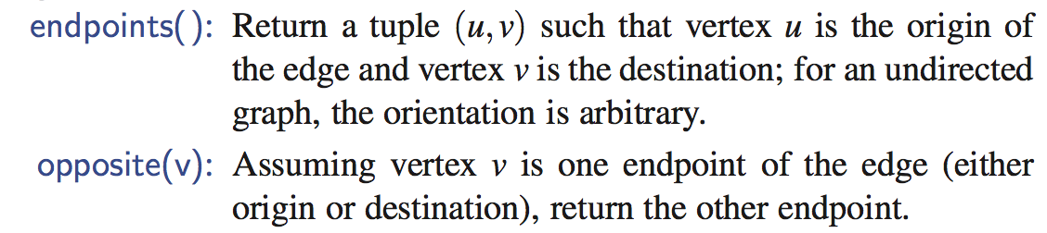
Vertices and Edges
A graph is a collection of vertices and edges.
We model the abstraction as a combination of three data types: Vertex, Edge, and Graph.
A Vertex is a lightweight object that stores an arbitrary element provided by the user (e.g., an airport code)
We assume it supports a method, element(), to retrieve the stored element.
An Edge stores an associated object (e.g., a flight number, travel distance, cost), retrieved with the element( ) method.
In addition, we assume that an Edge supports the following methods:

Slide 10
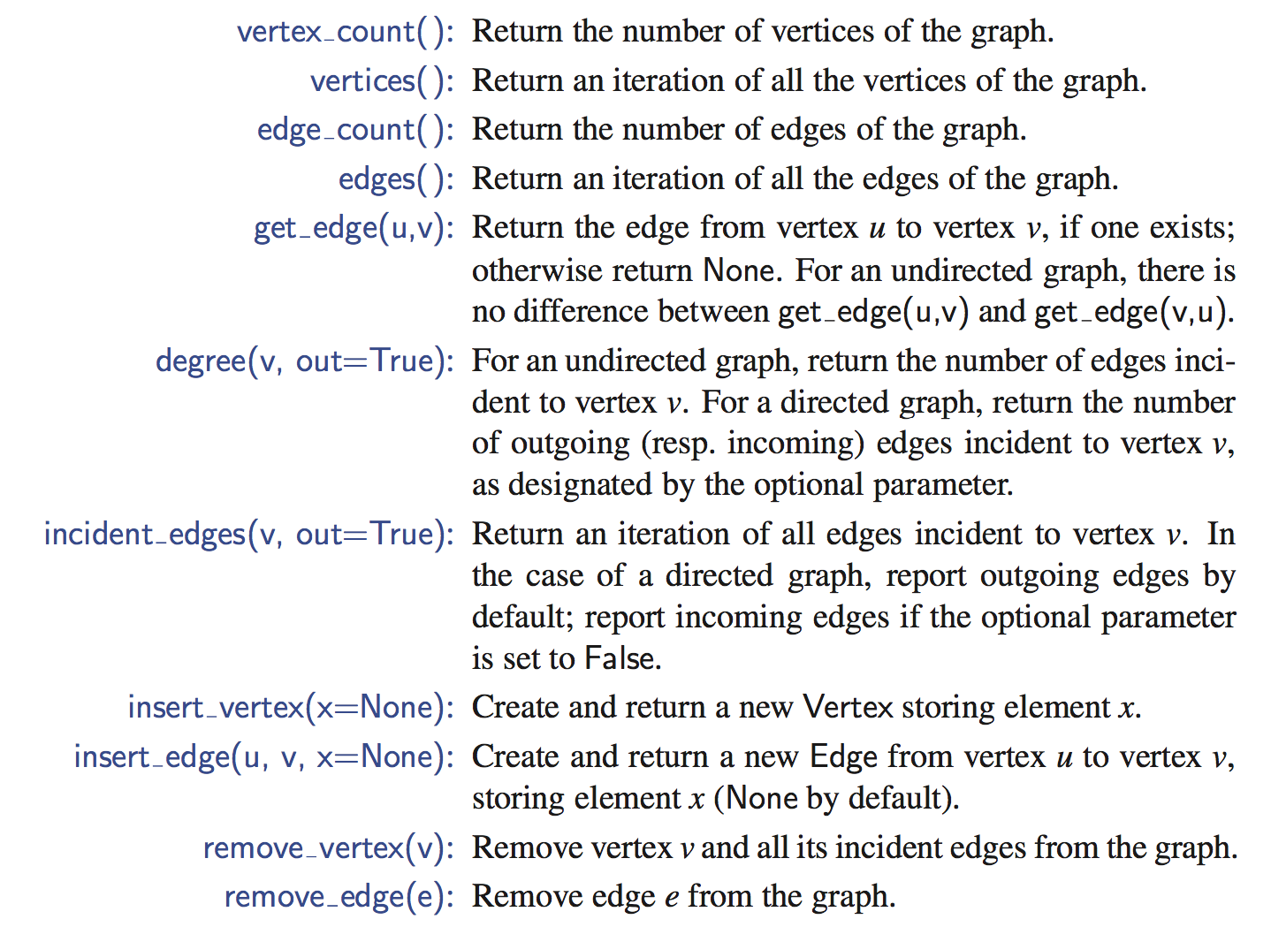
Graph ADT

Slide 11
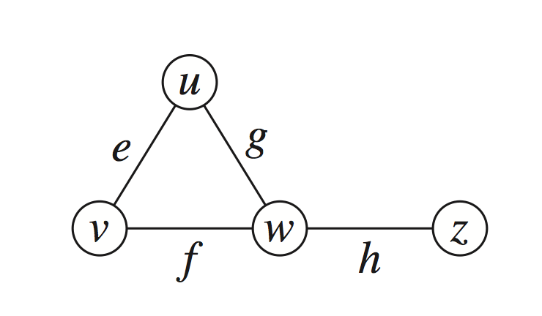
Edge List Structure
Vertex object
element
reference to position in vertex sequence
Edge object
element
origin vertex object
destination vertex object
reference to position in edge sequence
Vertex sequence
sequence of vertex objects
Edge sequence
sequence of edge objects
edges = [(u,v), (u,w), (v,w), (w,z)]

Slide 12
Adjacency List Structure
Lists neighbors for each vertex
{
u: [v, w],
v: [u, w],
w: [u, v, z],
z: [w]
}

Slide 13
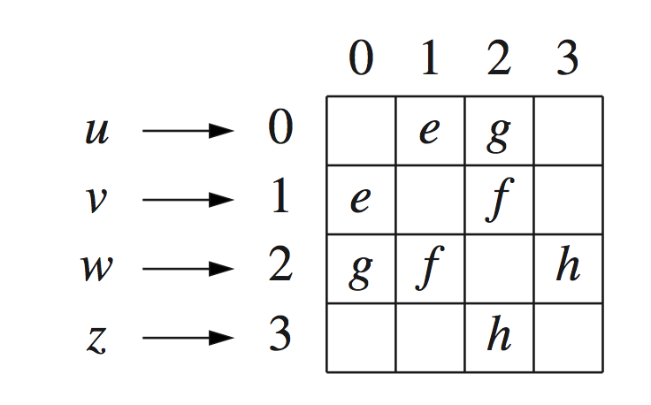
Adjacency Matrix Structure
Edge list structure
Augmented vertex objects
Integer key (index) associated with vertex
2D-array adjacency array
Reference to edge object for adjacent vertices
Null for non nonadjacent vertices
The “old fashioned” version just has 0 for no edge and 1 for edge

Slide 14
Performance
n vertices, m edges no parallel edges no self-loops | Edge List | Adjacency List | Adjacency Matrix
Space | n + m | n + m | n²
incidentEdges(v) | m | deg(v) | n
areAdjacent (v, w) | m | min(deg(v), deg(w)) | 1
insertVertex(o) | 1 | 1 | n²
insertEdge(v, w, o) | 1 | 1 | 1
removeVertex(v) | m | deg(v) | n²
removeEdge(e) | 1 | 1 | 1

Slide 15
Python Graph Libs
NetworkX : General graph implementation.
Pytorch Geometric : Generally used in Graph Neural Network implementations.

Slide 16
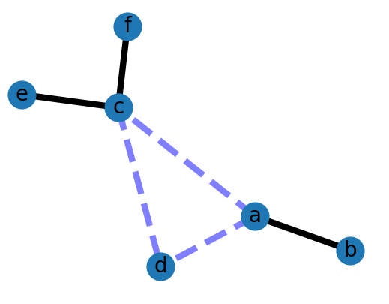
NetworkX Example
import matplotlib.pyplot as plt
import networkx as nx
G = nx.Graph()
G.add_edge('a', 'b', weight=0.6)
G.add_edge('a', 'c', weight=0.2)
G.add_edge('c', 'd', weight=0.1)
G.add_edge('c', 'e', weight=0.7)
G.add_edge('c', 'f', weight=0.9)
G.add_edge('a', 'd', weight=0.3)
elarge = [(u, v) for (u, v, d) in G.edges(data=True) if d['weight'] > 0.5]
esmall = [(u, v) for (u, v, d) in G.edges(data=True) if d['weight'] <= 0.5]
pos = nx.spring_layout(G) # positions for all nodes
nx.draw_networkx_nodes(G, pos, node_size=700)
nx.draw_networkx_edges(G, pos, edgelist=elarge,width=6)
nx.draw_networkx_edges(G, pos, edgelist=esmall,width=6, alpha=0.5, edge_color='b', style='dashed')
nx.draw_networkx_labels(G, pos, font_size=20, font_family='sans-serif')
plt.axis('off')
plt.show()

Slide 17
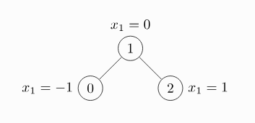
Pytorch Geometric Example
import torch
from torch_geometric.data import Data
edge_index = torch.tensor([[0, 1, 1, 2],
[1, 0, 2, 1]], dtype=torch.long)
x = torch.tensor([[-1], [0], [1]], dtype=torch.float)
data = Data(x=x, edge_index=edge_index)
>>> Data(edge_index=[2, 4], x=[3, 1])

Slide 18
Python Graph Implementation
We use a variant of the adjacency map representation.
For each vertex v, we use a Python dictionary to represent the secondary incidence map I(v).
The list V is replaced by a top-level dictionary D that maps each vertex v to its incidence map I(v).
Note that we can iterate through all vertices by generating the set of keys for dictionary D.
A vertex does not need to explicitly maintain a reference to its position in D, because it can be determined in O(1) expected time.
Running time bounds for the adjacency-list graph ADT operations, given above, become expected bounds.

Slide 19
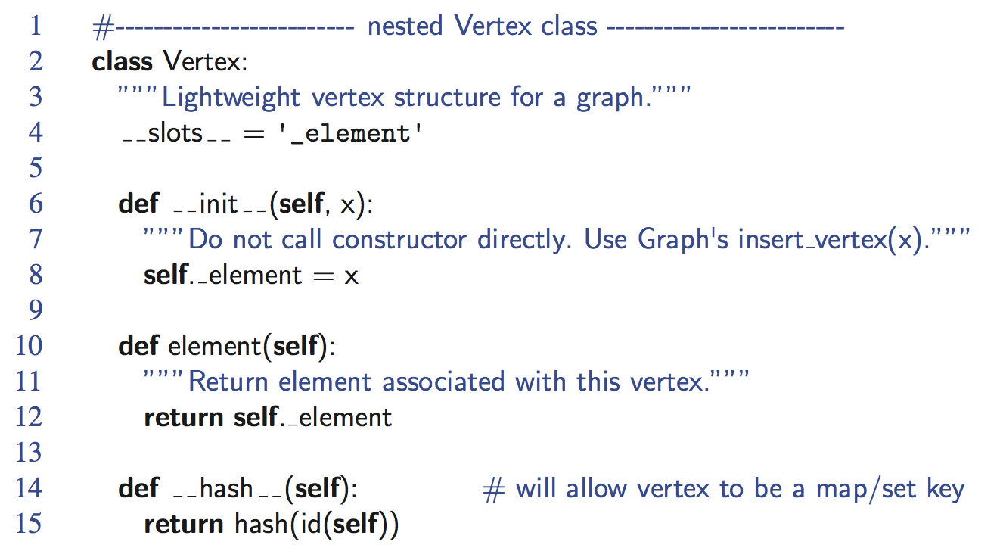
Vertex Class

Slide 20
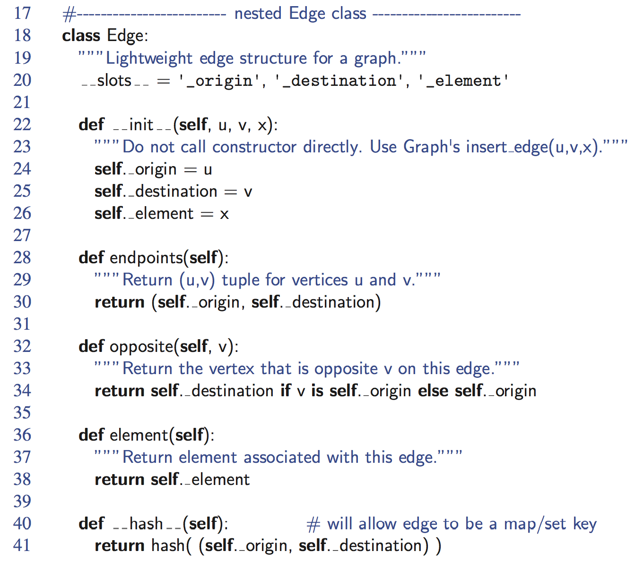
Edge Class

Slide 21
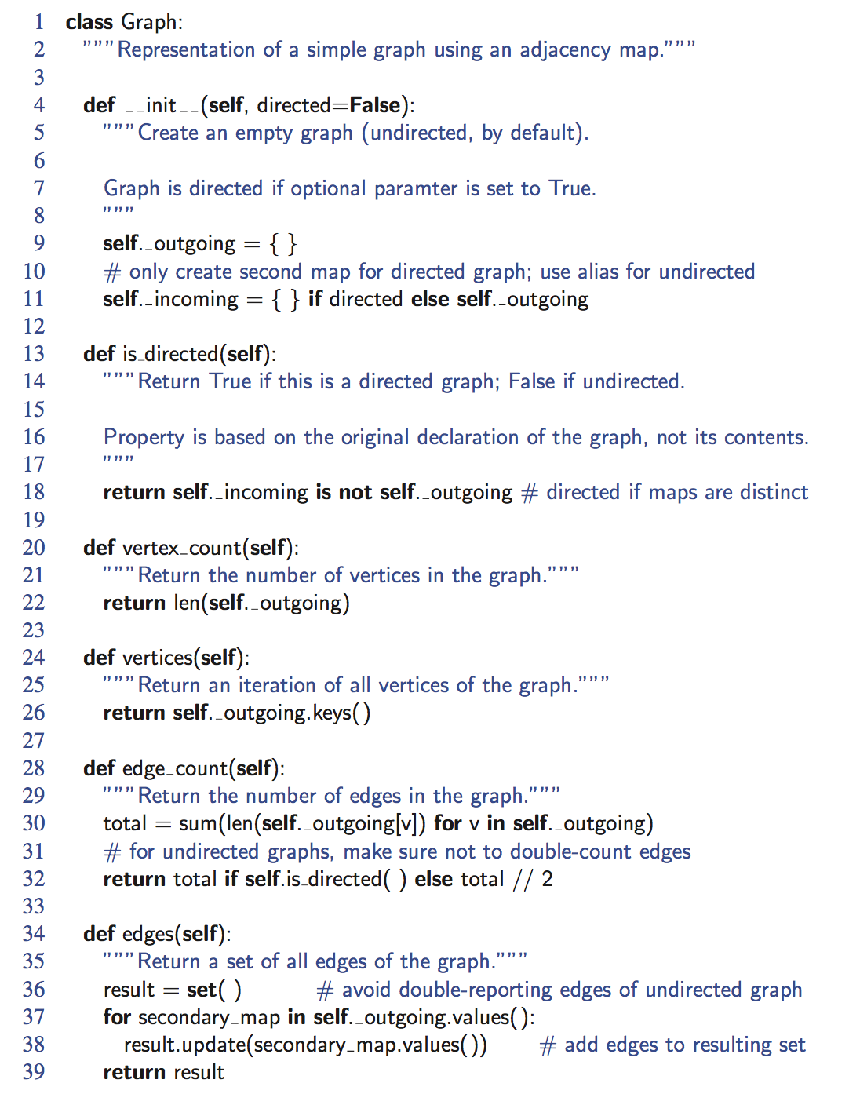
Graph, Part 1

Slide 22
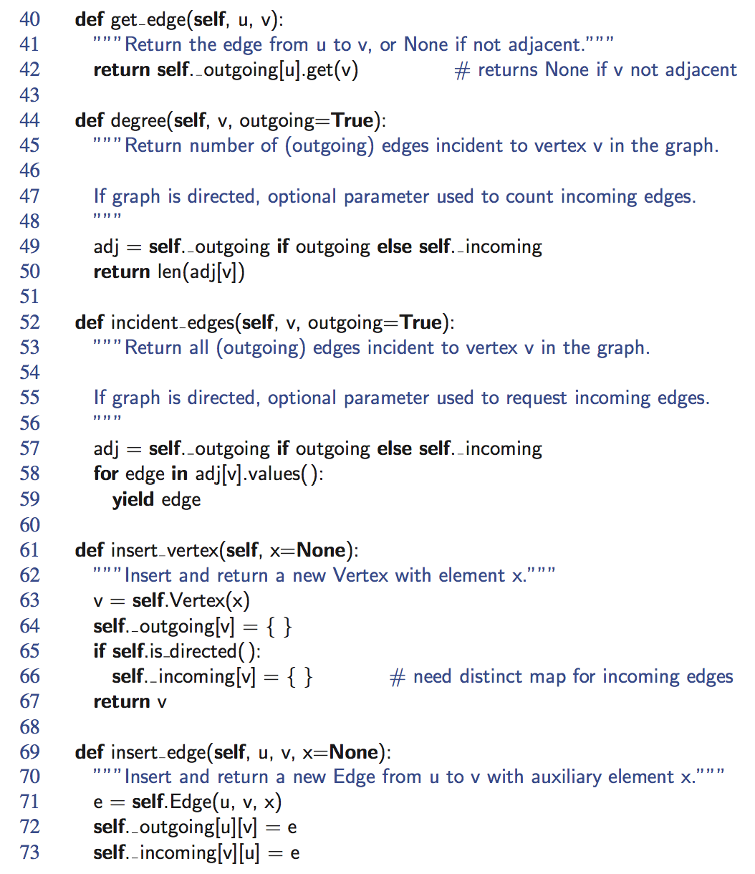
Graph, Part 2

Slide 23
Subgraphs
A subgraph S of a graph G is a graph such that
The vertices of S are a subset of the vertices of G
The edges of S are a subset of the edges of G
A spanning subgraph of G is a subgraph that contains all the vertices of G
Subgraph
Spanning subgraph

Slide 24
Connectivity
A graph is connected if there is a path between every pair of vertices
A connected component of a graph G is a maximal connected subgraph of G
Connected graph
Non connected graph with two connected components

Slide 25
Trees and Forests
A (free) tree is an undirected graph T such that
T is connected
T has no cycles
This definition of tree is different from the one of a rooted tree
A forest is an undirected graph without cycles
The connected components of a forest are trees
Tree
Forest

Slide 26
Spanning Trees and Forests
A spanning tree of a connected graph is a spanning subgraph that is a tree
A spanning tree is not unique unless the graph is a tree
Spanning trees have applications to the design of communication networks
A spanning forest of a graph is a spanning subgraph that is a forest
Graph
Spanning tree

Slide 27
Depth-First Search
Depth-first search (DFS) is a general technique for traversing a graph
A DFS traversal of a graph G
Visits all the vertices and edges of G
Determines whether G is connected
Computes the connected components of G
Computes a spanning forest of G
DFS on a graph with n vertices and m edges takes O(n + m ) time
DFS can be further extended to solve other graph problems
Find and report a path between two given vertices
Find a cycle in the graph
Depth-first search is to graphs what Euler tour is to binary trees

Slide 28
DFS Algorithm
The algorithm uses a mechanism for setting and getting “labels” of vertices and edges
Algorithm DFS(G, v)
Input graph G and a start vertex v of G
Output labeling of the edges of G in the connected component of v as discovery edges and back edges
setLabel(v, VISITED)
for all e ∈ G.incidentEdges(v)
if getLabel(e) = UNEXPLORED
w ← opposite(v,e)
if getLabel(w) = UNEXPLORED
setLabel(e, DISCOVERY)
DFS(G, w)
else
setLabel(e, BACK)
Algorithm DFS(G)
Input graph G
Output labeling of the edges of G as discovery edges and back edges
for all u ∈ G.vertices()
setLabel(u, UNEXPLORED)
for all e ∈ G.edges()
setLabel(e, UNEXPLORED)
for all v ∈ G.vertices()
if getLabel(v) = UNEXPLORED
DFS(G, v)

Slide 29
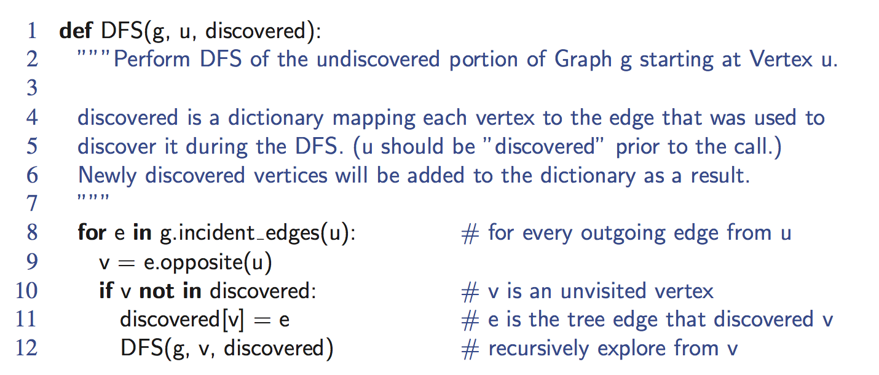
Python Implementation

Slide 30
Example
A
unexplored vertex
A
A
visited vertex
B
D
E
unexplored edge
discovery edge
C
back edge
A
A
B
D
E
B
D
E
C
C

Slide 31
Example (cont.)
A
A
B
D
E
B
D
E
C
C
A
A
B
D
E
B
D
E
C
C

Slide 32
DFS and Maze Traversal
The DFS algorithm is similar to a classic strategy for exploring a maze
We mark each intersection, corner and dead end (vertex) visited
We mark each corridor (edge ) traversed
We keep track of the path back to the entrance (start vertex) by means of a rope (recursion stack)

Slide 33
Properties of DFS
Property 1
DFS(G, v) visits all the vertices and edges in the connected component of v
Property 2
The discovery edges labeled by DFS(G, v) form a spanning tree of the connected component of v
A
B
D
E
C

Slide 34
Analysis of DFS
Setting/getting a vertex/edge label takes O(1) time
Each vertex is labeled twice
once as UNEXPLORED
once as VISITED
Each edge is labeled twice
once as UNEXPLORED
once as DISCOVERY or BACK
Method incidentEdges is called once for each vertex
DFS runs in O(n + m) time provided the graph is represented by the adjacency list structure
Recall that Σ_{v} deg(v) = 2m

Slide 35
Path Finding
We can specialize the DFS algorithm to find a path between two given vertices u and z using the template method pattern
We call DFS(G, u) with u as the start vertex
We use a stack S to keep track of the path between the start vertex and the current vertex
As soon as destination vertex z is encountered, we return the path as the contents of the stack
Algorithm pathDFS(G, v, z)
setLabel(v, VISITED)
S.push(v)
if v = z
return S.elements()
for all e ∈ G.incidentEdges(v)
if getLabel(e) = UNEXPLORED
w ← opposite(v,e)
if getLabel(w) = UNEXPLORED
setLabel(e, DISCOVERY)
S.push(e)
pathDFS(G, w, z)
S.pop(e)
else
setLabel(e, BACK)
S.pop(v)

Slide 36
Cycle Finding
We can specialize the DFS algorithm to find a simple cycle using the template method pattern
We use a stack S to keep track of the path between the start vertex and the current vertex
As soon as a back edge (v, w) is encountered, we return the cycle as the portion of the stack from the top to vertex w
Algorithm cycleDFS(G, v, z)
setLabel(v, VISITED)
S.push(v)
for all e ∈ G.incidentEdges(v)
if getLabel(e) = UNEXPLORED
w ← opposite(v,e)
S.push(e)
if getLabel(w) = UNEXPLORED
setLabel(e, DISCOVERY)
pathDFS(G, w, z)
S.pop(e)
else
T ← new empty stack
repeat
o ← S.pop()
T.push(o)
until o = w
return T.elements()
S.pop(v)

Slide 37
Breadth-First Search
Breadth-first search (BFS) is a general technique for traversing a graph
A BFS traversal of a graph G
Visits all the vertices and edges of G
Determines whether G is connected
Computes the connected components of G
Computes a spanning forest of G
BFS on a graph with n vertices and m edges takes O(n + m ) time
BFS can be further extended to solve other graph problems
Find and report a path with the minimum number of edges between two given vertices
Find a simple cycle, if there is one

Slide 38
BFS Algorithm
The algorithm uses a mechanism for setting and getting “labels” of vertices and edges
Algorithm BFS(G)
Input graph G
Output labeling of the edges and partition of the vertices of G
for all u ∈ G.vertices()
setLabel(u, UNEXPLORED)
for all e ∈ G.edges()
setLabel(e, UNEXPLORED)
for all v ∈ G.vertices()
if getLabel(v) = UNEXPLORED
BFS(G, v)
Algorithm BFS(G, s)
L₀ ← new empty sequence
L₀.addLast(s)
setLabel(s, VISITED)
i ← 0
while ¬L_{i}.isEmpty()
L_{i +1} ← new empty sequence
for all v ∈ L_{i}.elements() for all e ∈ G.incidentEdges(v)
if getLabel(e) = UNEXPLORED
w ← opposite(v,e)
if getLabel(w) = UNEXPLORED
setLabel(e, DISCOVERY)
setLabel(w, VISITED)
L_{i +1}.addLast(w)
else
setLabel(e, CROSS)
i ← i +1

Slide 39
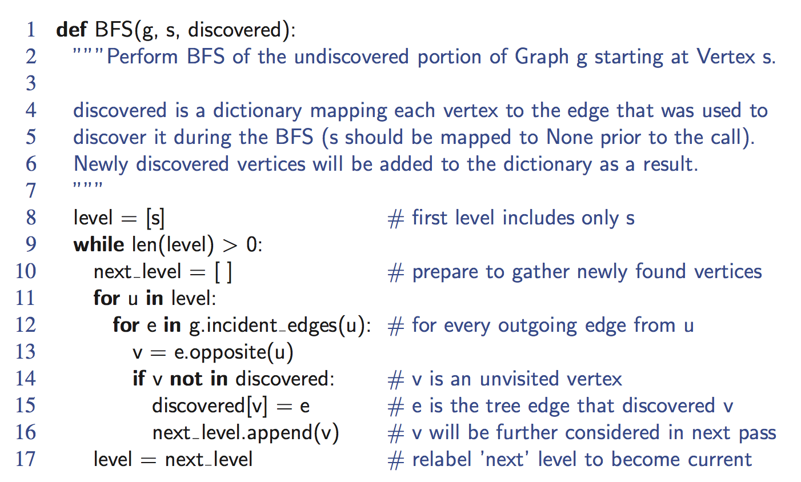
Python Implementation

Slide 40
Example
L₀
unexplored vertex
A
A
A
visited vertex
L₁
B
C
D
unexplored edge
discovery edge
E
F
cross edge
L₀
L₀
A
A
L₁
L₁
B
C
D
B
C
D
E
F
E
F

Slide 41
Example (cont.)
L₀
L₀
A
A
L₁
L₁
B
C
D
B
C
D
L₂
E
F
E
F
L₀
L₀
A
A
L₁
L₁
B
C
D
B
C
D
L₂
L₂
E
F
E
F

Slide 42
Example (cont.)
L₀
L₀
A
A
L₁
L₁
B
C
D
B
C
D
L₂
L₂
E
F
E
F
L₀
A
L₁
B
C
D
L₂
E
F

Slide 43
Properties
Notation
G_{s}: connected component of s
Property 1
BFS(G, s) visits all the vertices and edges of G_{s}
Property 2
The discovery edges labeled by BFS(G, s) form a spanning tree T_{s} of G_{s}
Property 3
For each vertex v in L_{i}
The path of T_{s} from s to v has i edges
Every path from s to v in G_{s} has at least i edges
A
B
C
D
E
F
L₀
A
L₁
B
C
D
L₂
E
F

Slide 44
Analysis
Setting/getting a vertex/edge label takes O(1) time
Each vertex is labeled twice
once as UNEXPLORED
once as VISITED
Each edge is labeled twice
once as UNEXPLORED
once as DISCOVERY or CROSS
Each vertex is inserted once into a sequence L_{i}
Method incidentEdges is called once for each vertex
BFS runs in O(n + m) time provided the graph is represented by the adjacency list structure
Recall that Σ_{v} deg(v) = 2m

Slide 45
Applications
Using the template method pattern, we can specialize the BFS traversal of a graph G to solve the following problems in O(n + m) time
Compute the connected components of G
Compute a spanning forest of G
Find a simple cycle in G, or report that G is a forest
Given two vertices of G, find a path in G between them with the minimum number of edges, or report that no such path exists

Slide 46
DFS vs BFS
 | Depth First Search (DFS) | Breadth First Search (BFS)
Data Structure | DFS uses Stack data structure. | BFS uses Queue data structure
Definition | DFS traversal approach in which the traverse begins at the root node and proceeds through the nodes as far as possible until we reach the node with no unvisited nearby nodes. | BFS is a traversal approach in which we first walk through all nodes on the same level before moving on to the next level.
Conceptual Difference | DFS builds the tree sub-tree by sub-tree. | BFS builds the tree level by level.
Approach used | It works on the concept of LIFO (Last In First Out). | It works on the concept of FIFO (First In First Out).
Suitable for | DFS is more suitable when there are solutions away from source. | BFS is more suitable for searching vertices closer to the given source.
Applications | DFS is used in various applications such as acyclic graphs and finding strongly connected components etc. | BFS is used in various applications such as bipartite graphs, shortest paths, etc.

Slide 47
DFS vs. BFS
Applications | DFS | BFS
Spanning forest, connected components, paths, cycles | √ | √
Shortest paths |  | √
Biconnected components | √
L₀
A
A
L₁
B
C
D
B
C
D
L₂
E
F
E
F
DFS
BFS

Slide 48
DFS vs. BFS (cont.)
Cross edge (v,w)
w is in the same level as v or in the next level
Back edge (v,w)
w is an ancestor of v in the tree of discovery edges
L₀
A
A
L₁
B
C
D
B
C
D
L₂
E
F
E
F
DFS
BFS

Slide 49
Directed Graphs
A directed graph is a graph whose edges are all directed
Applications
one-way streets
flights
task scheduling
E
D
C
B
A

Slide 50
Directed Graph Properties
E
D
A graph G=(V,E) such that
Each edge goes in one direction:
Edge (a,b) goes from a to b, but not b to a
If G is simple, m < n⋅(n − 1)
If we keep in-edges and out-edges in separate adjacency lists, we can perform listing of incoming edges and outgoing edges in time proportional to their size
C
B
A

Slide 51
Directed Graph Application
Scheduling: edge (a,b) means task a must be completed before b can be started
ics21
ics22
ics23
ics51
ics53
ics52
ics161
ics131
ics141
ics121
ics171
The good life
ics151

Slide 52
Directed DFS
We can specialize the traversal algorithms (DFS and BFS) to digraphs by traversing edges only along their direction
In the directed DFS algorithm, we have four types of edges
discovery edges
back edges
forward edges
cross edges
A directed DFS starting at a vertex s determines the vertices reachable from s
E
D
C
B
A

Slide 53
Reachability
DFS tree rooted at v: vertices reachable from v via directed paths
E
D
C
E
D
A
C
F
A
B
E
D
C
F
A
B

Slide 54
Weighted Graphs
In a weighted graph, each edge has an associated numerical value, called the weight of the edge
Edge weights may represent, distances, costs, etc.
Example:
In a flight route graph, the weight of an edge represents the distance in miles between the endpoint airports
849
PVD
1843
ORD
142
SFO
802
LGA
1743
1205
337
1387
HNL
2555
1099
LAX
1233
DFW
1120
MIA

Slide 55
Shortest Paths
Given a weighted graph and two vertices u and v, we want to find a path of minimum total weight between u and v.
Length of a path is the sum of the weights of its edges.
Example:
Shortest path between Providence and Honolulu
Applications
Internet packet routing
Flight reservations
Driving directions
849
PVD
1843
ORD
142
SFO
802
LGA
1743
1205
337
1387
HNL
2555
1099
LAX
1233
DFW
1120
MIA

Slide 56
Shortest Path Properties
Property 1:
A subpath of a shortest path is itself a shortest path
Property 2:
There is a tree of shortest paths from a start vertex to all the other vertices
Example:
Tree of shortest paths from Providence
849
PVD
1843
ORD
142
SFO
802
LGA
1743
1205
337
1387
HNL
2555
1099
LAX
1233
DFW
1120
MIA

Slide 57
Dijkstra’s Algorithm
The distance of a vertex v from a vertex s is the length of a shortest path between s and v
Dijkstra’s algorithm computes the distances of all the vertices from a given start vertex s
Assumptions:
the graph is connected
the edges are undirected
the edge weights are nonnegative
We grow a “cloud” of vertices, beginning with s and eventually covering all the vertices
We store with each vertex v a label d(v) representing the distance of v from s in the subgraph consisting of the cloud and its adjacent vertices
At each step
We add to the cloud the vertex u outside the cloud with the smallest distance label, d(u)
We update the labels of the vertices adjacent to u

Slide 58
Edge Relaxation
Consider an edge e = (u,z) such that
u is the vertex most recently added to the cloud
z is not in the cloud
The relaxation of edge e updates distance d(z) as follows:
d(z) ← min{d(z),d(u) + weight(e)}
d(u) = 50
10
d(z) = 75
u
e
s
z
d(u) = 50
10
d(z) = 60
u
e
s
z

Slide 59
Example
0
0
8
A
4
8
A
4
2
2
8
7
2
1
4
8
7
2
1
3
B
C
D
B
C
D
∞
3
9
∞
5
3
9
8
2
E
F
5
2
E
F
5
0
0
8
A
4
8
A
4
2
2
8
7
2
1
3
7
7
2
1
3
B
C
D
B
C
D
5
3
9
11
5
3
9
8
2
E
F
5
2
E
F
5

Slide 60
Example (cont.)
0
8
A
4
2
7
7
2
1
3
B
C
D
5
3
9
8
2
E
F
5
0
8
A
4
2
7
7
2
1
3
B
C
D
5
3
9
8
2
E
F
5

Slide 61
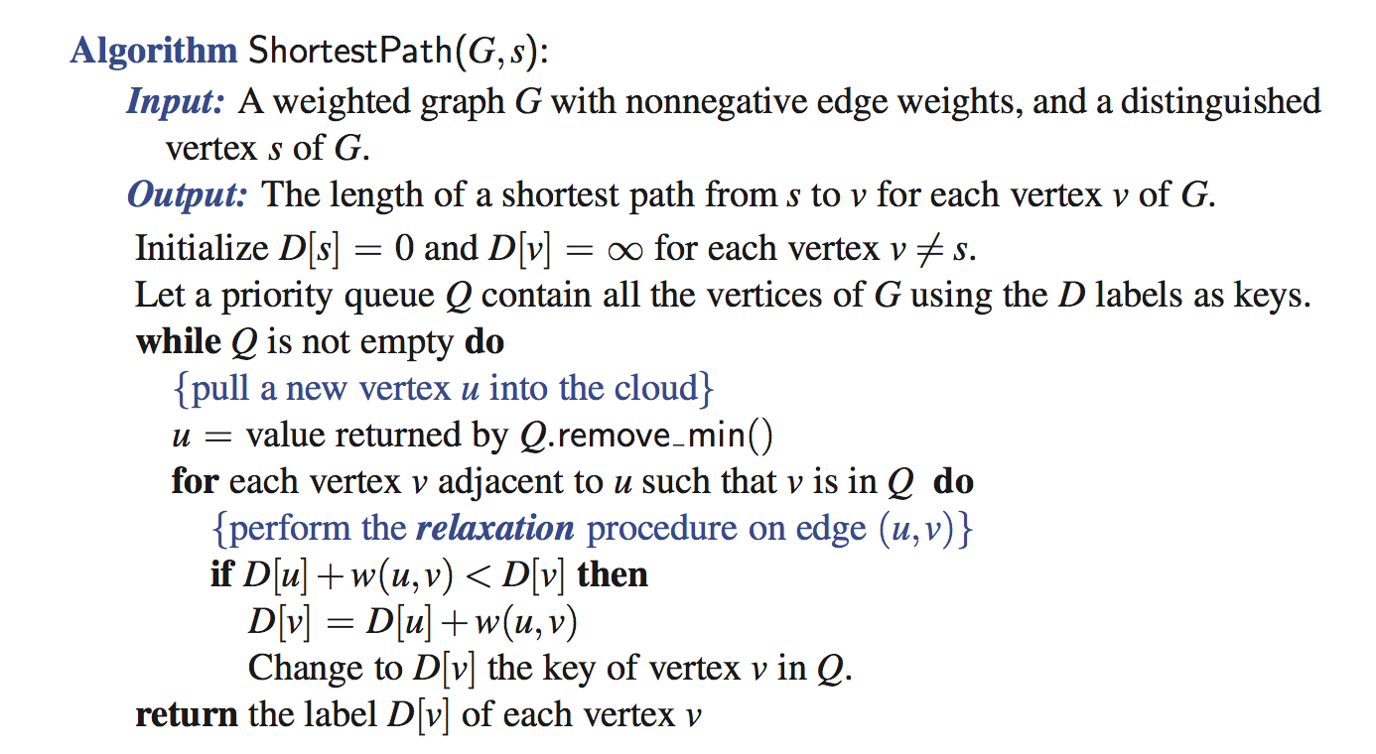
Dijkstra’s Algorithm

Slide 62
Analysis of Dijkstra’s Algorithm
Graph operations
We find all the incident edges once for each vertex
Label operations
We set/get the distance and locator labels of vertex z O(deg(z)) times
Setting/getting a label takes O(1) time
Priority queue operations
Each vertex is inserted once into and removed once from the priority queue, where each insertion or removal takes O(log n) time
The key of a vertex in the priority queue is modified at most deg(w) times, where each key change takes O(log n) time
Dijkstra’s algorithm runs in O((n + m) log n) time provided the graph is represented by the adjacency list/map structure
Recall that Σ_{v} deg(v) = 2m
The running time can also be expressed as O(m log n) since the graph is connected

Slide 63
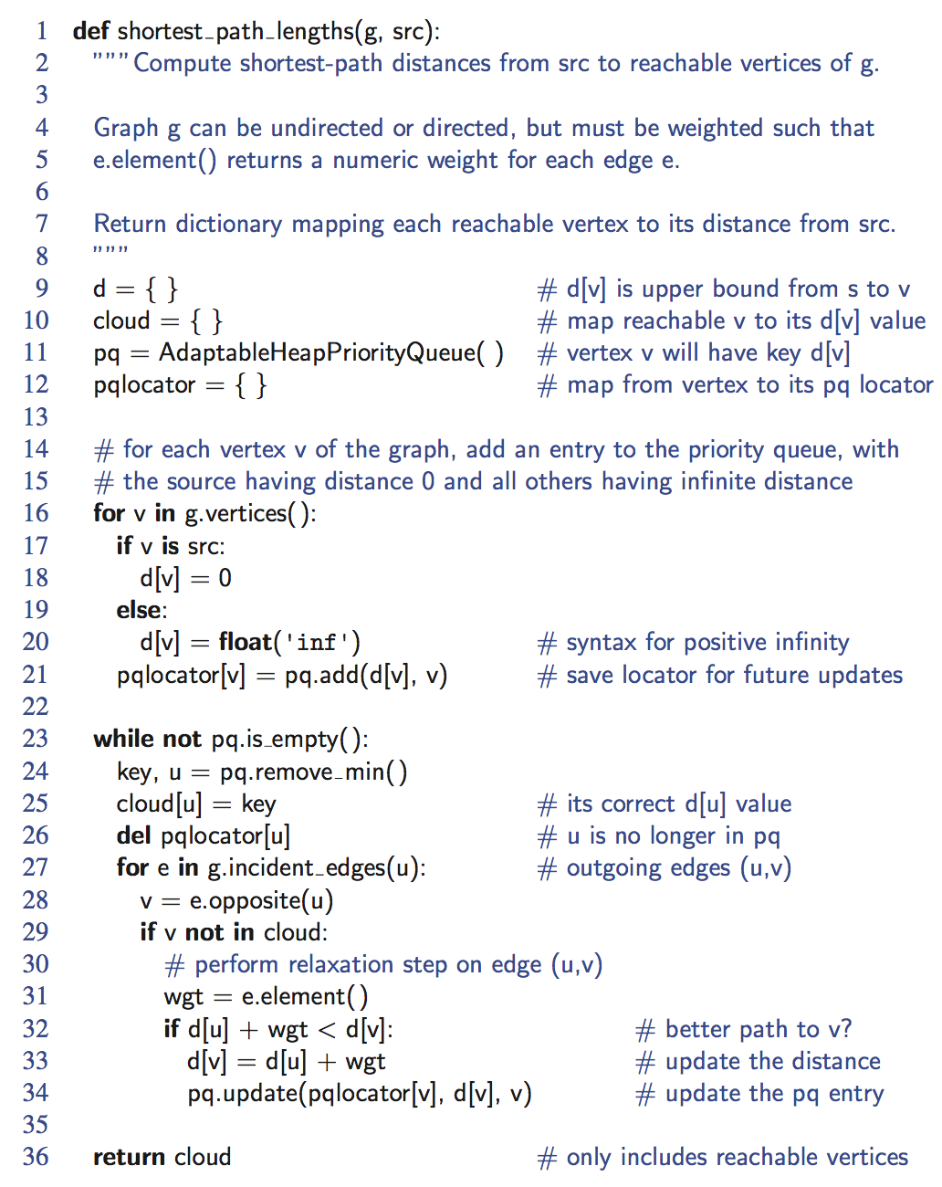
Python Implementation

Slide 64
Why Dijkstra’s Algorithm Works
Dijkstra’s algorithm is based on the greedy method. It adds vertices by increasing distance.
Suppose it didn’t find all shortest distances. Let F be the first wrong vertex the algorithm processed.
When the previous node, D, on the true shortest path was considered, its distance was correct
But the edge (D,F) was relaxed at that time!
Thus, so long as d(F)>d(D), F’s distance cannot be wrong. That is, there is no wrong vertex
0
8
A
4
2
7
7
2
1
3
B
C
D
5
3
9
8
2
E
F
5

